Slide 1

CORONA VIRUS AnalySIs
By : Nithya dharshini

Slide 2
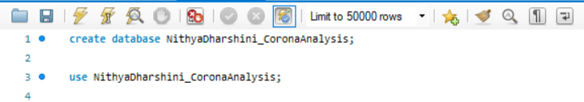
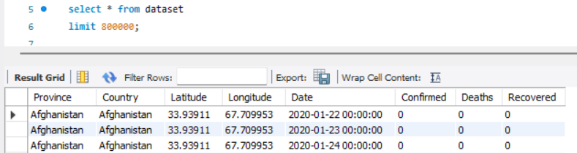
Initial database creation
I had first created the database
Then I imported the given csv file under schemas using ‘table data import wizard’
Then I went through the dataset to have a basic understanding of the dataset

Slide 3
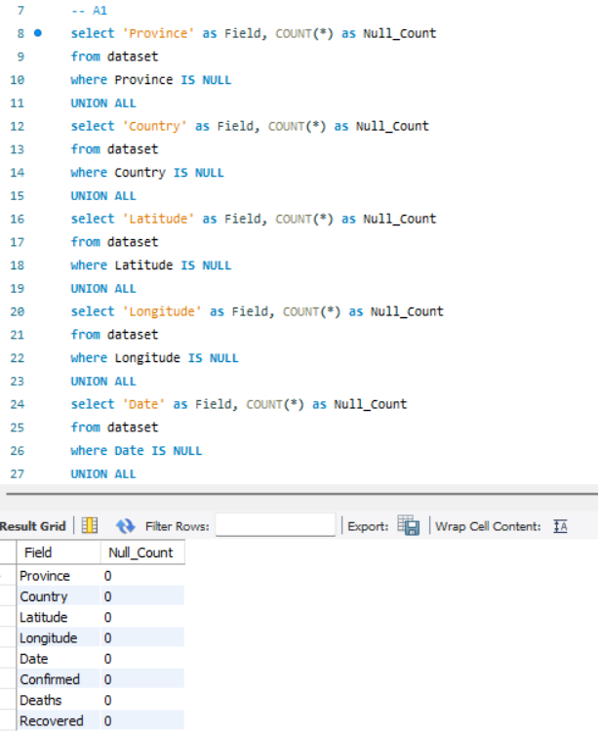
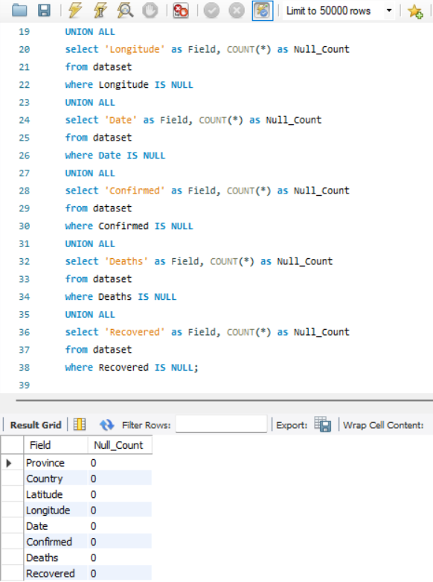
Q1. & Q2.
Write a code to check null values and update if null values are present
Insights
We can see from the results that there are no null values present in the corona dataset

Slide 4
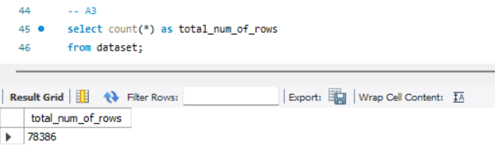
Q3.
Check total number of rows
Insights
There are 78,386 rows in total

Slide 5
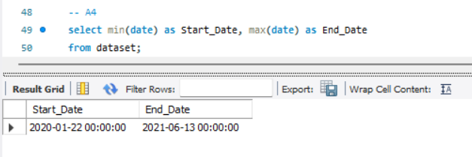
Q4.
Check what is start_date and end_date
Insights
We can see that corona started on 22nd January 2020 and lasted till 13th june 2021

Slide 6
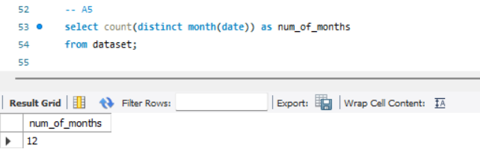
Q5.
Number of months present in the dataset
Insights
There are 12 months present in the corona dataset

Slide 7
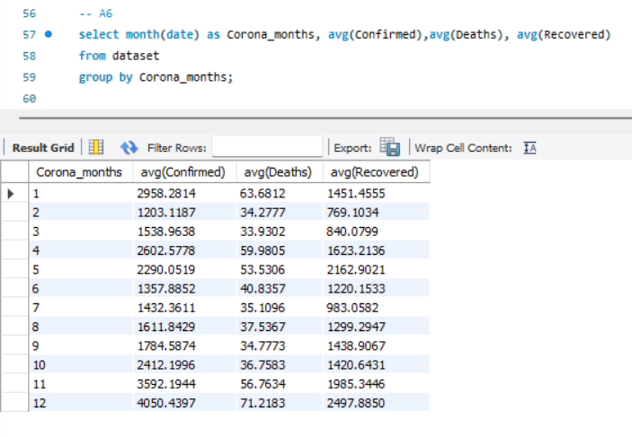
Q6.
Find monthly average of confirmed, deaths and recovered
Insights
We can see the average number of confirmed cases, number of deaths and number of recovered spread across the 12 months of the year

Slide 8
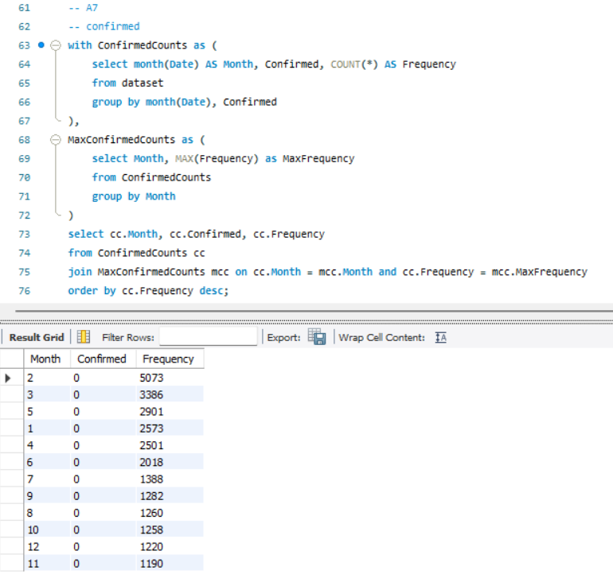
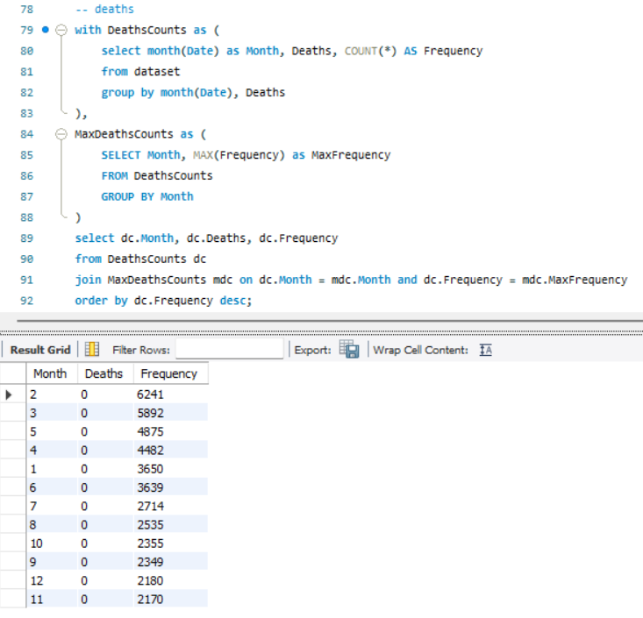
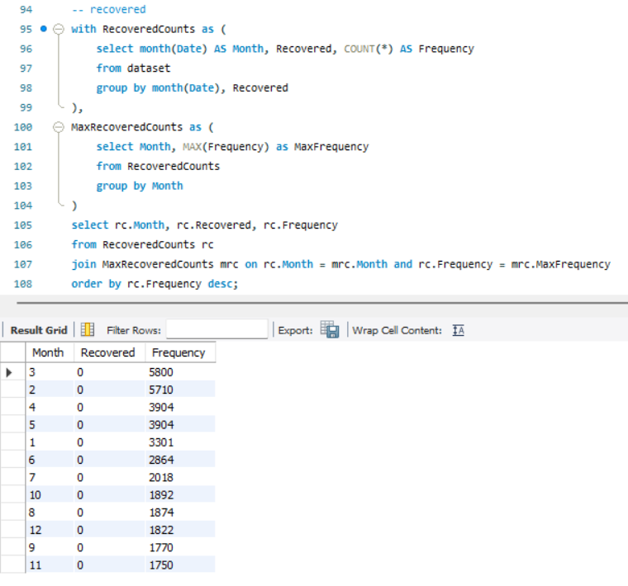
Q7.
Find most frequent value of confirmed, deaths and recovered each month
Insights
We can see the most frequent number of confirmed, death and recovered cases each month

Slide 9
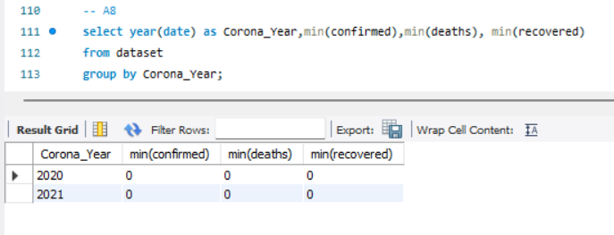
Q8.
Find minimum values of confirmed, deaths and recovered per year
Insights
We can see that the minimum number of confirmed, deaths and recovered cases are all 0

Slide 10
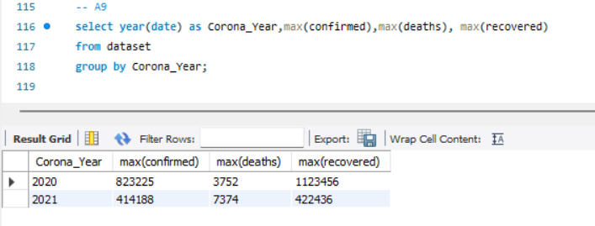
Q9.
Find maximum values of confirmed, deaths and recovered per year
Insights
The maximum cases for confirmed, deaths and recovered for the year 2020 are 823225, 3752,1123456 respectively.
The maximum cases for confirmed, deaths and recovered for the year 2021 are 414188,7374,422436 respectively.

Slide 11
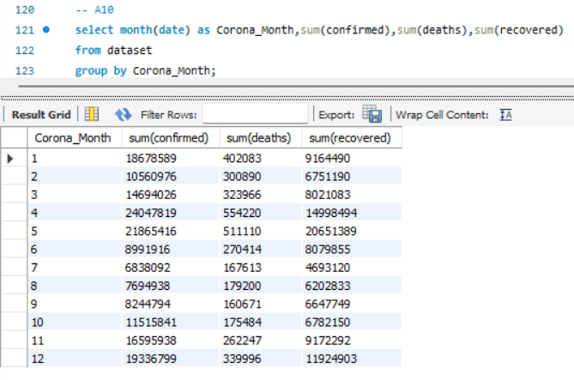
Q10.
Total number of case of confirmed, deaths and recovered per month
Insights
We can see the total number of case of confirmed, deaths and recovered per month in the output table

Slide 12
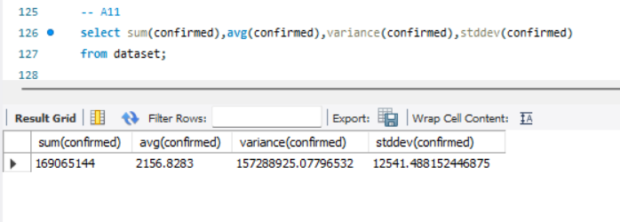
Q11.
Check how corona virus spread out with respect to confirmed cases
Insights
The huge number of confirmed cases suggest that there were many confirmed cases of corona.
We can see that, on an average, around 2157 people were confirmed to have corona every month.
The high variance and high standard deviation suggest that there were great fluctuations in the number of confirmed cases each month.

Slide 13
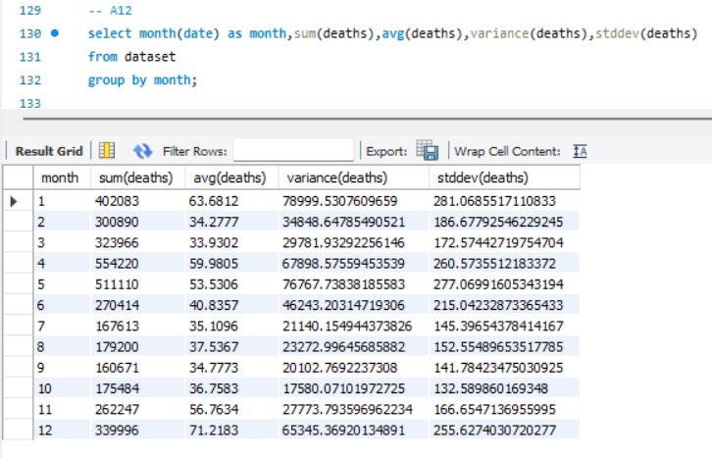
Q12.
Check how corona virus spread out with respect to death case per month
Insights
We can see the total number of deaths, average number of deaths, variance and standard deviation spread across the months.

Slide 14
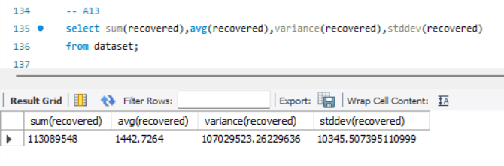
Q13.
Check how corona virus spread out with respect to recovered cases
Insights
The huge number of recovered cases suggest that many were recovered.
We can see that, on an average, around 1443 people were recovered every month.
The high variance and high standard deviation suggest that there were great fluctuations in the number of recovered cases each month.

Slide 15
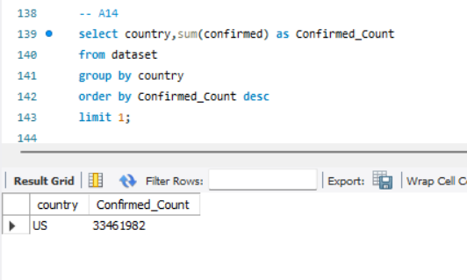
Q14.
Find the country having highest number of confirmed cases
Insights
We can see that The united states of America had the most number of confirmed cases with 33461982 confirmed cases.

Slide 16
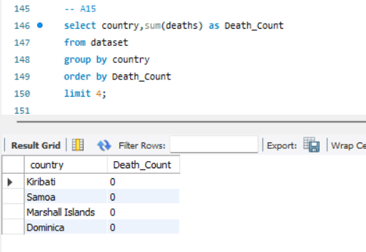
Q15.
Find the country having lowest number of deaths
Insights
We can see that Kribati, samoa, marshall islands and dominica had the least number of deaths with 0 deaths.

Slide 17
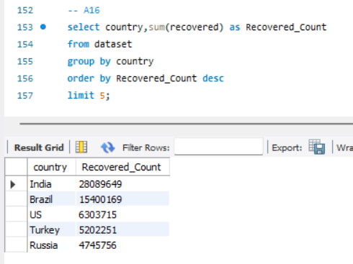
Q16.
Find t0p 5 countries having highest recovered cases
Insights
We can see that India, brazil, us, turkey and russia had the highest number of recovered cases.

Slide 18
Thank you!

